Slide 1
Heading | Page No.
Who we are | 2
What we do | 3
Founders | 4
Disability in India | 5
Hunger issue in India | 7
Medical emergencies | 9
Our mission | 10
Our Vision | 11
Completed projects | 12
Running projects | 24
Future projects | 27
Media | 28
Well-wishers | 31
Legal documents | 34

Slide 2
Who we are
Hope Begins Foundation is a Non-Government Organization which works in various areas for helping society at large and the needful people.
We are a group of friends who started as a trust in 2017 with a vision to bring back hopes to those people in the society who are looked upon as incapable or inefficient due to the limitations in their physical body. But we believed that those so called disabled people, whom we call as Differently-abled instead of disabled, have great potential in them to showcase their talents. All they needed was an opportunity or rather a platform to prove themselves, especially in the field of sports. Hence we organized cricket tournaments for those differently abled people and till now we have completed multiple projects at various places in the country like Delhi, Uttar Pradesh, Rajasthan and Madhya Pradesh.
With the success of all those projects, our vision expanded and simultaneously we started providing ration and food packets to the underprivileged.
Once started as a trust, now we got ourselves registered as a Section 8 company in February 2021.

Slide 3
What we do
We work primarily for 3 causes :
Sports tournaments for differently-abled
We organize sports tournaments for differently-abled people to give them a platform and fulfil their dreams. We have organized multiple tournaments in Delhi, Uttar Pradesh, Rajasthan and Madhya Pradesh.
Food distribution to the underprivileged
We distribute ration and food packets among the underprivileged section of the society. Since the beginning of the first wave of pandemic, we have already distributed more than 25 lacs meals and are still counting. We have successfully completed a mission to take care of ration and food for 1500 families for 3 months. We call our food packets as Happiness kits because along with distribution we conduct entertainment activities for the underprivieged kids as well.
Financial support for medical emergencies
We all know how expensive hospital bills are now a days. During such a crisis we know how badly a family gets affected mentally. On top of that financial burden makes the situation worse. Hence we help such families who need financial support during such medical emergencies.

Slide 4
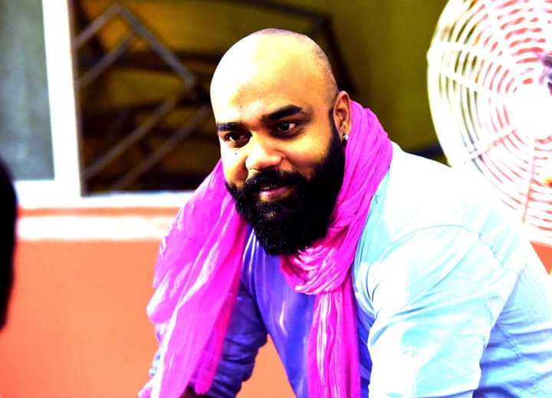
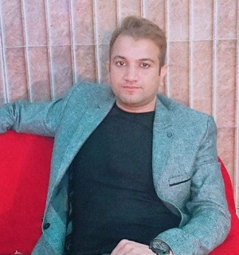
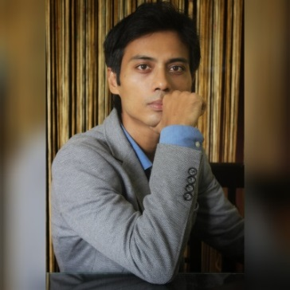
Founders
PRANAV MISHRA - Founder and Director
A dynamic professional from the last 11 years. He is an Entrepreneur with proficiency in managing the necessary business relationship and organizational structure, effective communicator, and negotiator with strong analytical, problem-solving, and organizational abilities. He holds a Degree from Swami Shraddhanand College Delhi and Masters in Management from IMT, Ghaziabad. He holds several recognitions for social works.
SHOAIB ALI - Founder and Director
Entrepreneur with demonstrated acumen in overcoming complex business challenges and making high-stakes decisions using experience-backed judgment and strong work ethic. He holds a Degree in Commerce (Hons.) from Jamia Millia Islamia and Masters in Management from Wigan and Leigh College, Delhi. He is a social worker by heart and has been doing social activities for the last 5 years.
BITUPAN BARUAH – Co-Founder and CMO
Bachelor of Engineering with 10 years of corporate experience in Sales and Marketing. He is a Life Coach and Wellness coach. A fitness expert who made a record for fitness in India Book of records. He is a public speaker as well. Delivered speeches at various platforms including Joshtalks and also hosts his own talk show. Has been invited as a guest speaker at various events.

Slide 5
Disability in India
Overall, 2.21% of Indian population has one or the other kind of disability. This means 2.68 crore (26.8 million) people in India are disabled.
Disabled Male Population
Out of total 62.32 crore male Indian citizens, there are 1.5 crore disabled males in India.
Disabled Female Population
Out of total 58.76 crore female Indian citizens, there are 1.18 crore disabled females in India.
Disabled Population living in Rural / Urban Areas
About 69% of the overall disabled Indian population lives rural areas. This tells us that 1.86 crore disabled people live in rural areas.
Only about 0.81 crore disabled people live in urban areas.

Slide 6
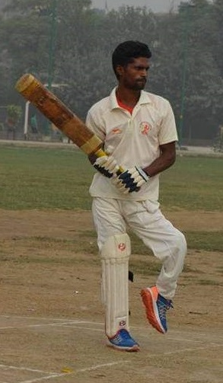
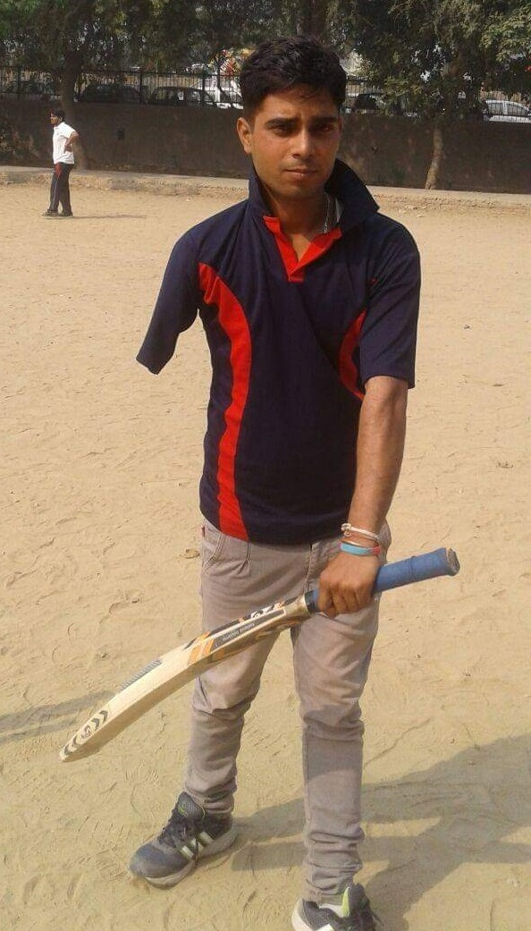
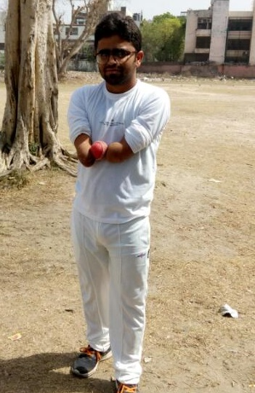
In pictures : Players of Differently-abled cricket team of Hope Begins Foundation

Slide 7
Hunger issue in India
189.2 million people i.e. 14% of our population is undernourished
20% of children under 5 are underweight
34.7% of children under 5 years of age are stunted
51.4% women in the reproductive age (15-49 years) are anaemic

Slide 8
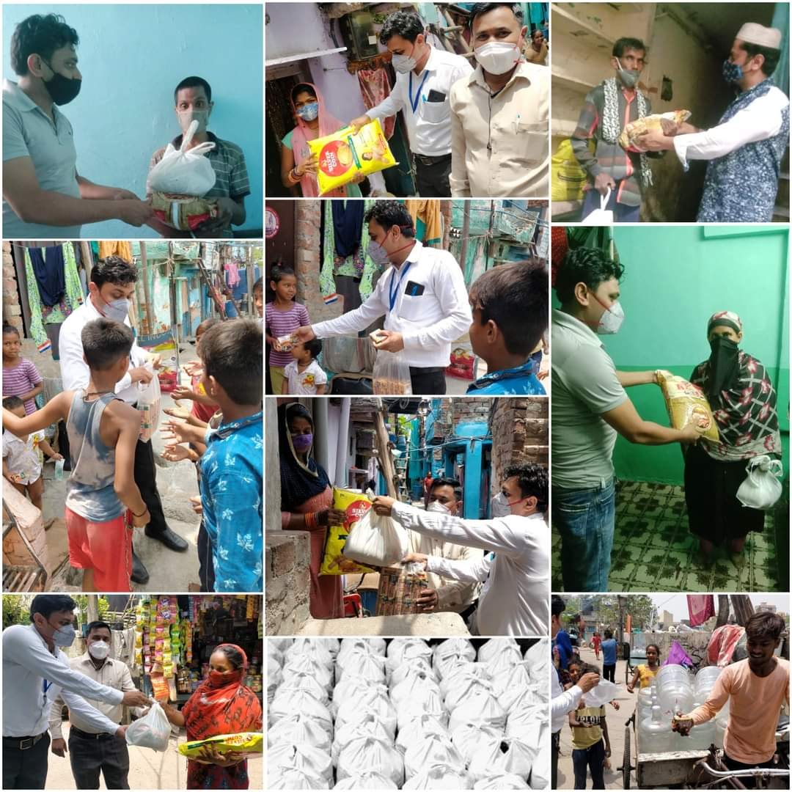
In pictures : Volunteers of Hope Begins Foundation distributing food packets.

Slide 9
Medical emergencies
Medical emergencies can happen to anybody. The hospital bills have sky rocketed now a days. A single emergency can make a family lose their entire life’s savings. Sometimes even that’s not enough and families are forced to sell their wealth/properties to arrange money.
Sometimes delay in funds arrangement may get on the way of an urgent medical treatment. Nothing is more valuable than a human life. Hence we help people who needs huge amount of money to save the life of their family members.

Slide 10
Our Mission
- To work as a catalyst in bringing sustainable change in the lives of the needy and the underprivileged section of the society.
- To bring back hopes to those who are looked upon as hopeless in the society because of physical disabilities or poor financial conditions.
- To see a world free of hunger where nobody has to ever worry about a basic necessity like food.
- To see a world where every individual has equal right and dignity in the society irrespective of their physical condition or financial status.

Slide 11
Our Vision
INTEGRITY
We are committed to honesty, accountability and transparency in all our endeavours.
INCLUSIVENESS
We will work with others to help the world’s needy regardless of race, gender, age, creed or nationality, colour, political affiliation or belief.
PROFESSIONALISM, TEAM WORK AND EXCELLENCE
We value effective teamwork and collaboration when delivering professional services. We strive to attain the highest standards in all that we do, and we are committed to participatory decision making.
INNOVATIVENATIVESS AND CREATIVITY
Pursuing innovative and effective solutions, creative ideas and ongoing improvement. Innovation is a key driver for our growth.

Slide 12
Past projects
1) The Rising Cup - 1
Venue- Shakarpur DDA ground, New Delhi
Date- 7th Jan, 2017
Team- Madhya Pradesh vs Delhi
Winner- Delhi
Chief Guests- Mr. Nitin Tyagi (MLA for AAP Party),
Mr J.P. Soni ( MD of JP Constructions)
Media Coverage- Punjab Kesari

Slide 13
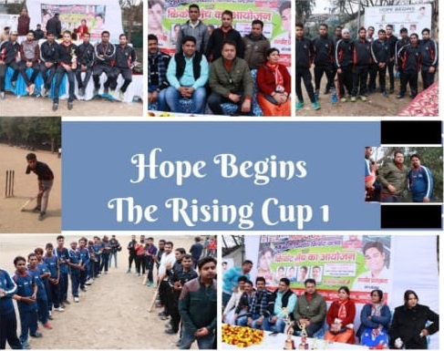

Slide 14
2) The Rising Cup - 2, Tri- Series
Venue- Shakarpur DDA ground, New Delhi
Date- 15 - 16 April, 2017
Teams- Delhi, Rajasthan and VRC ( Vocational rehabilitation centre)
Winner- Delhi
Chief Guests- Mr. Anand Saini (International Golfer),
Mr. Nand Ram Sharma (Congress Leader)
Media Coverage- Punjab Kesari

Slide 16
3) The Rising Cup - 3
Venue- DDA playground, Laxmi Nagar, New Delhi
Date- 12th Nov, 2017
Teams- Delhi, Rajasthan and Haryana
Winner- Delhi
Chief Guests- Ms. Shabnam Khan (Human Rights Activist),
Mr. Anand Saini ( International Golfer)
Media Coverage- Punjab kesari and Jagaran

Slide 17
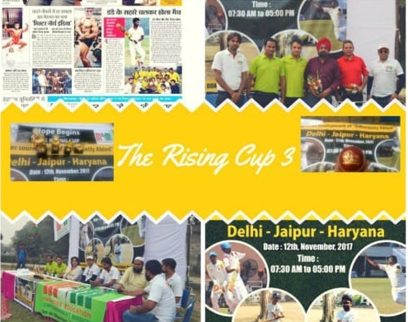

Slide 18
4) Delhi team tour of Bhopal
Venue- Bhopal, Madhya Pradesh
Date- 10th March, 2018
Team- Delhi and Madhya Pradesh
Each and every basic care of team was taken care by Hope Begins team. And we also provided basics facilities to Delhi team such as fare, dresses, cricket equipments, and majorly we paid them cash rewards to all players for their extraordinary performances.

Slide 19
5) Delhi team tour of Mewat
Venue- Mewat, Haryana
Date- 14th October, 2018
Team- Haryana and Delhi
Each and every basic care of team was taken care by Hope Begins team. And we also provided basics facilities to Delhi team such as fare, dresses, cricket equipments, and majorly we paid them cash rewards to all players for their extraordinary performances.

Slide 20
6) Delhi Team tour of Jaipur
Venue- Jaipur, Rajasthan
Date- 2nd November, 2019
Team- Jaipur and Delhi
Each and every basics care of team was taken care by Hope Begins team. And also we provided basics facilities to Delhi team such as fares, dresses, cricket equipments, and majorly we paid them cash rewards to all players for their extraordinary performances.

Slide 21
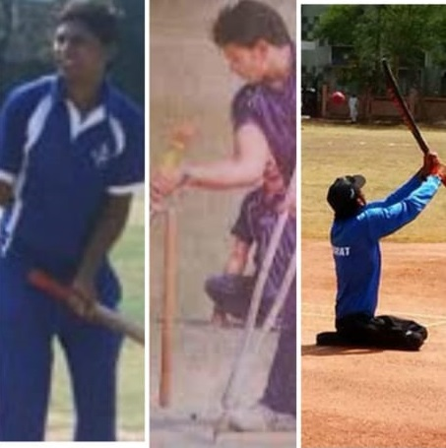

Slide 22
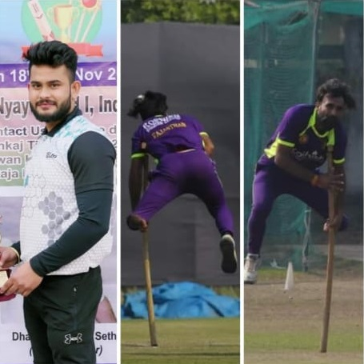
7) The Rising Cup - 4
Venue- TNM Cricket Academy, Indirapuram, Ghaziabad.
Date- 18th November, 2020.
Teams- Delhi v/s Haryana
Winner- Delhi

Slide 23
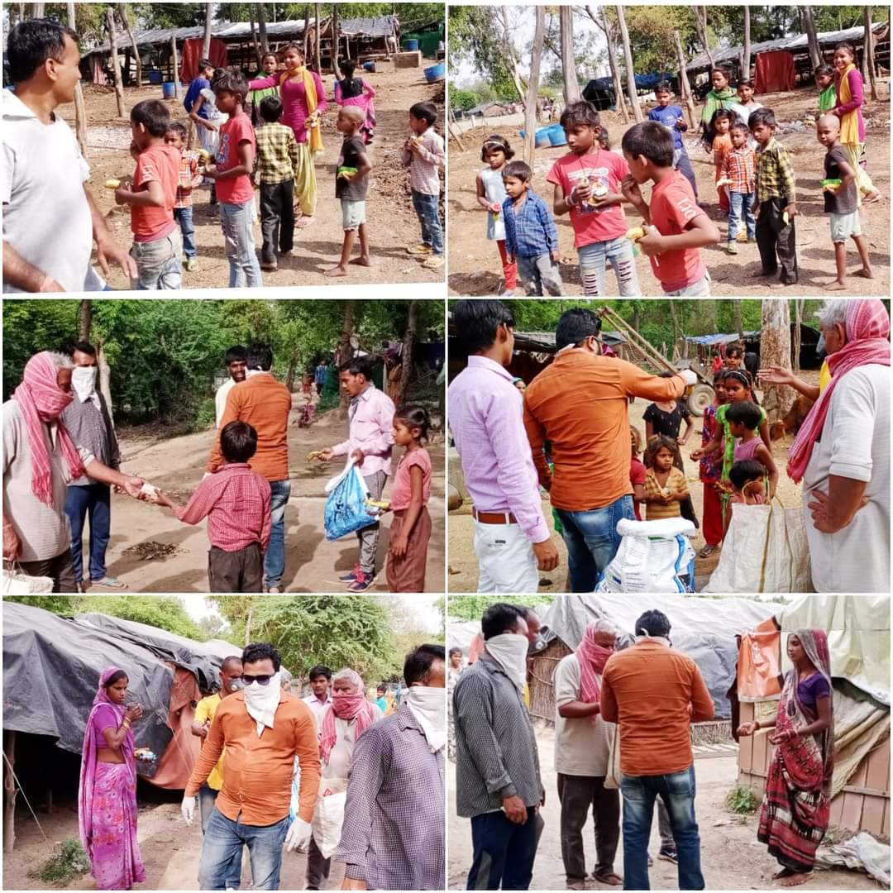
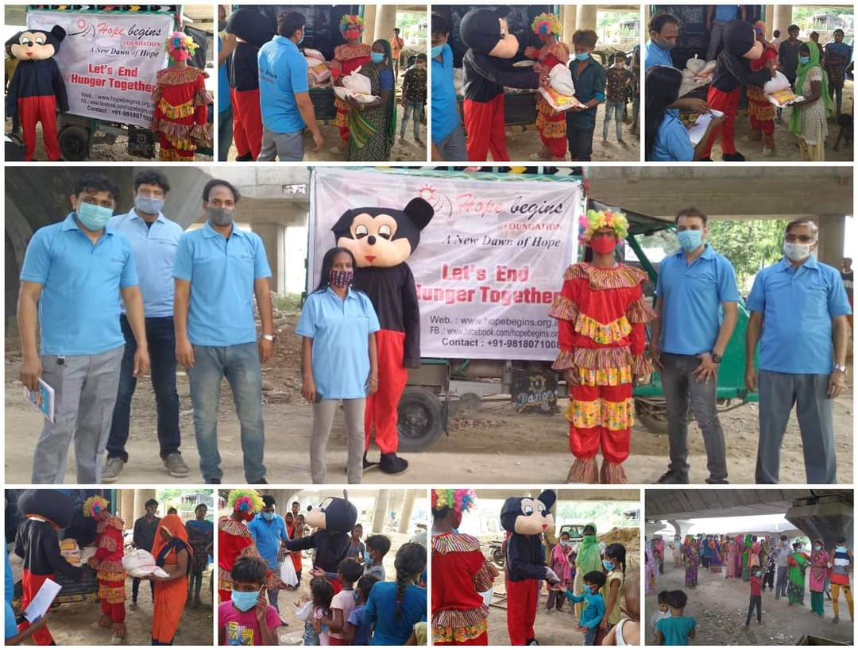
8) Covid relief project
Distributed more than 25 lacs meals to the underprivileged at various locations in Delhi, Uttar Pradesh, Rajasthan.

Slide 24
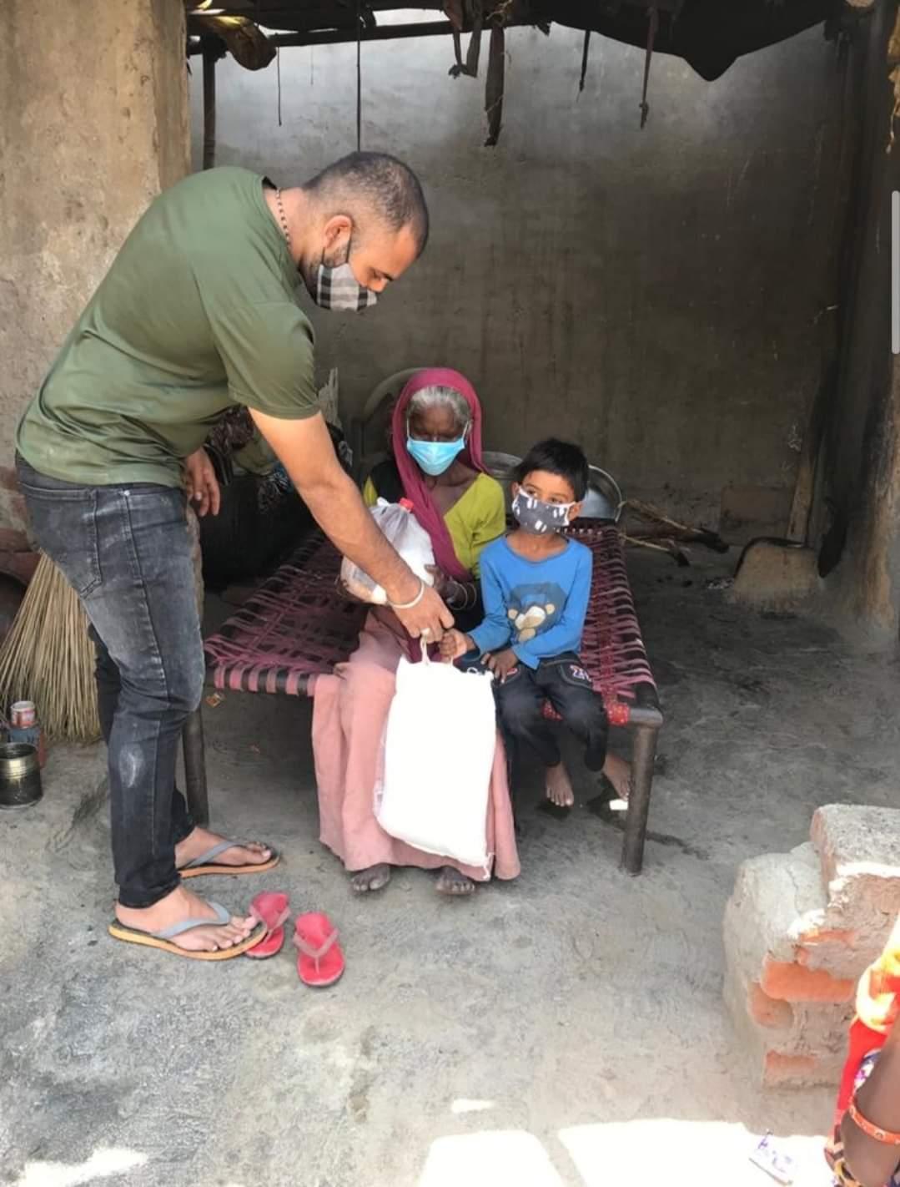
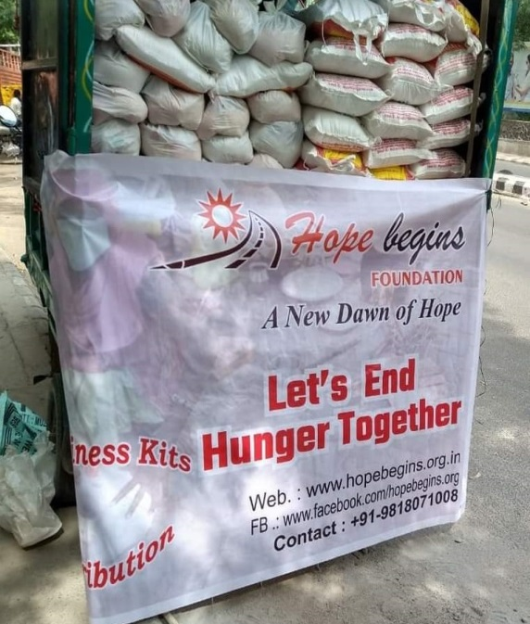
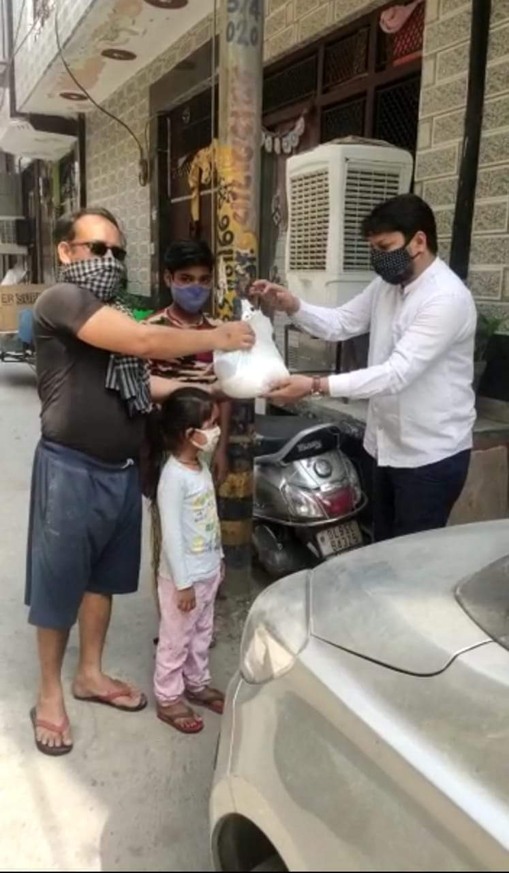

Slide 25
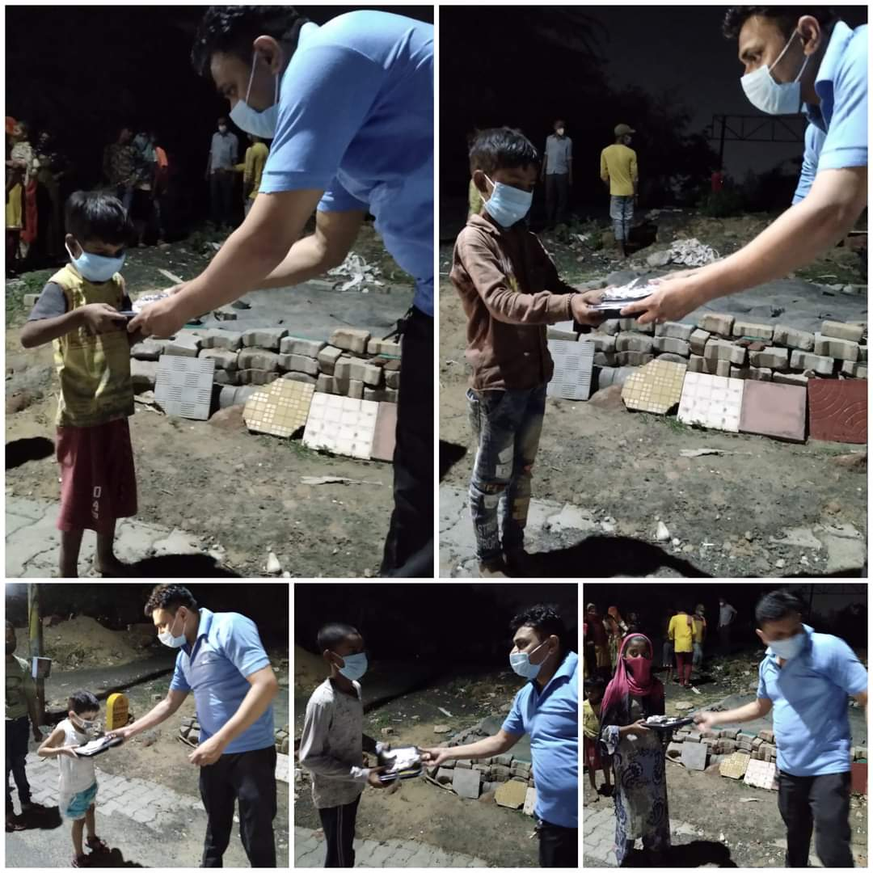
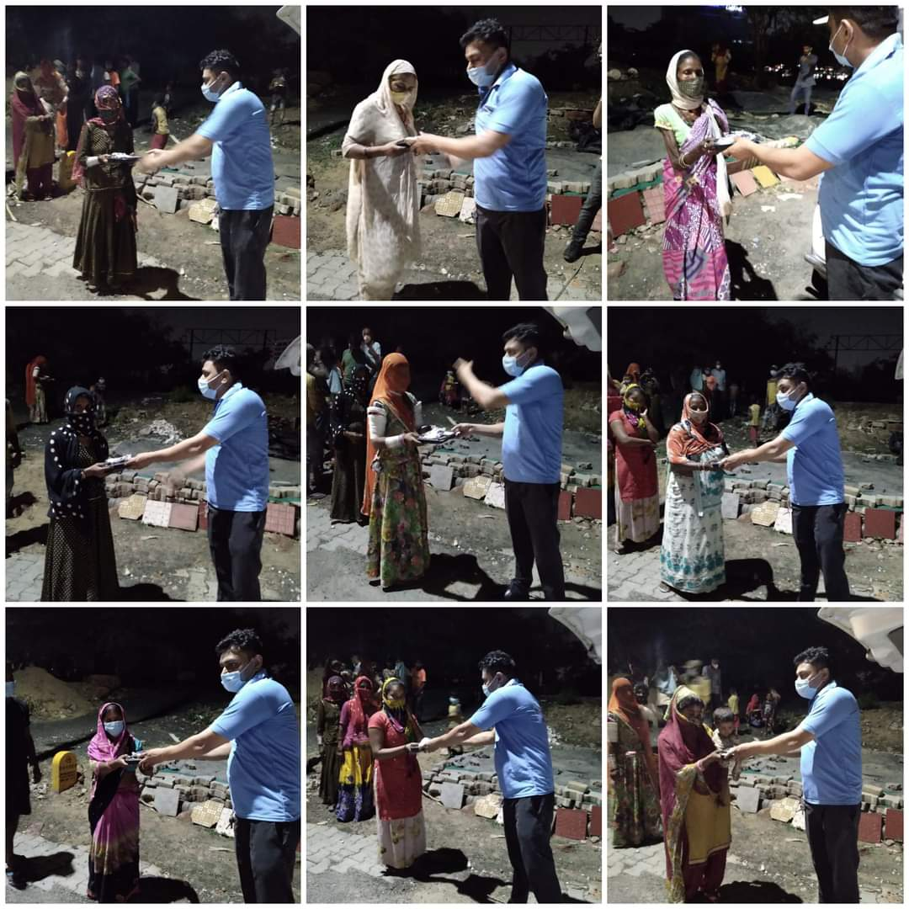
9) Mission 1500 families for 3 months
We took up a mission of providing ration to 1500 families for 3 months during the second wave of pandemic and have successfully completed this mission. We not only provided ration packets but also distributed cooked meals for those families who didn’t have cooking facilities at home.

Slide 26
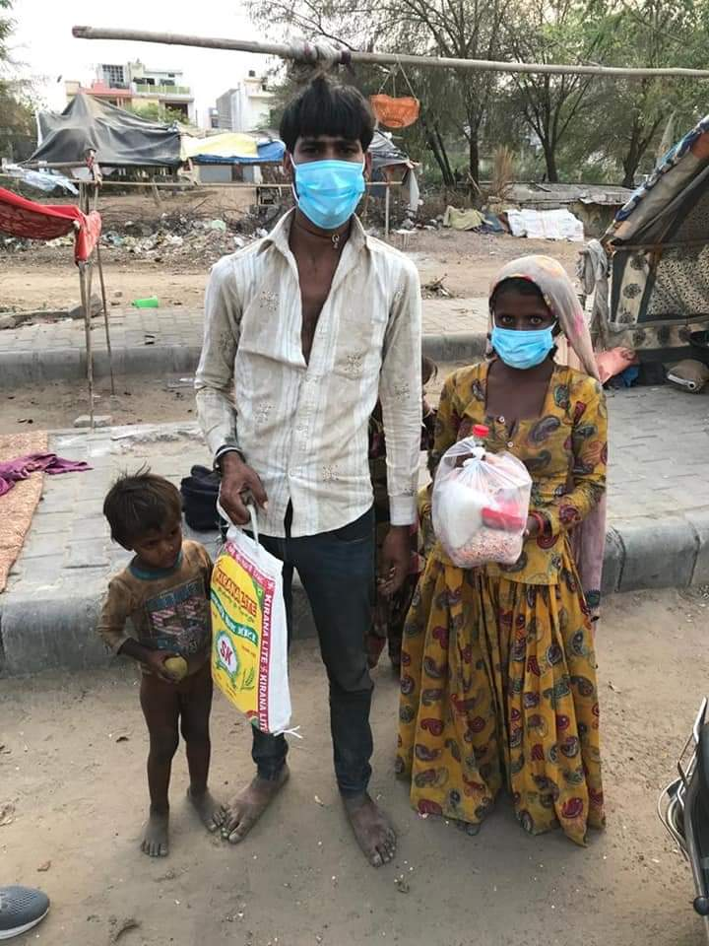
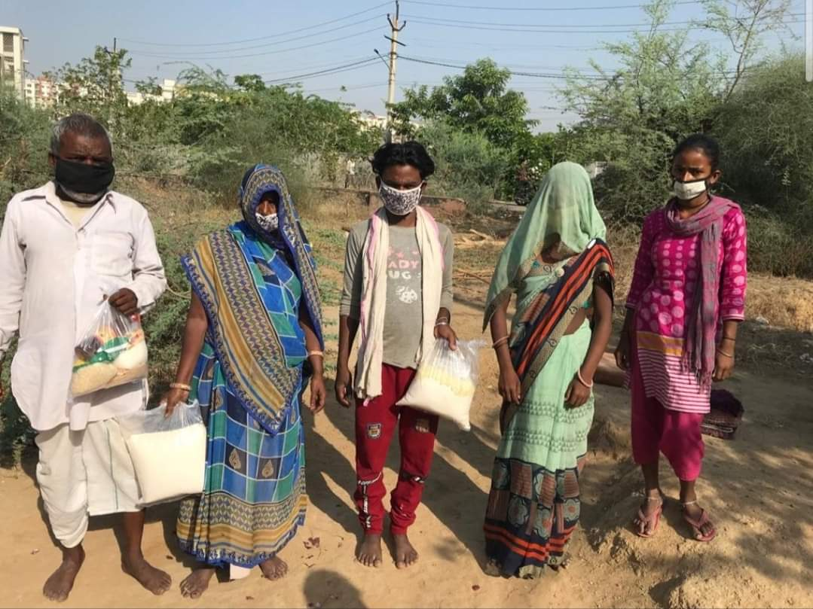
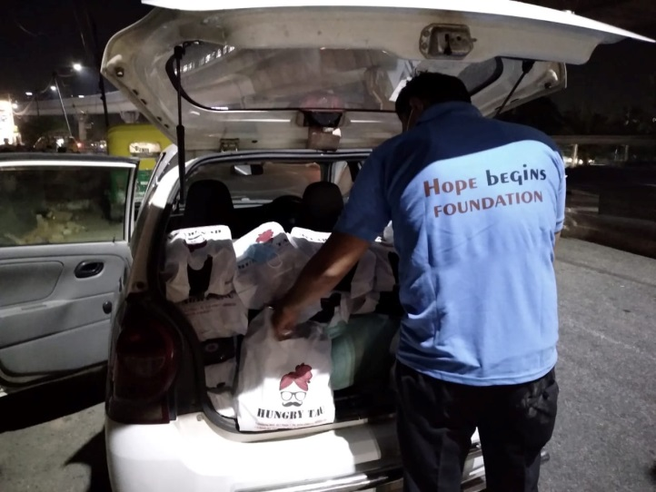
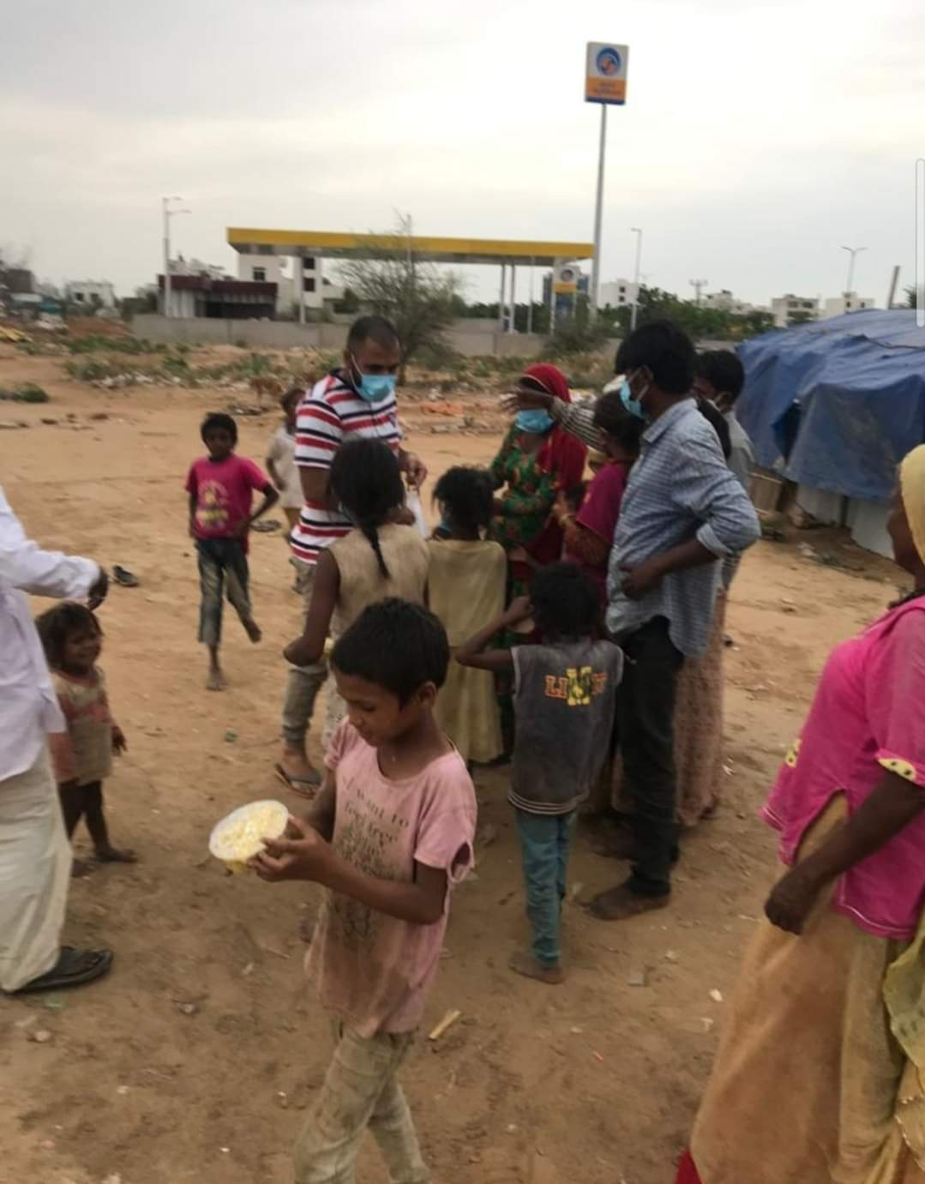

Slide 27
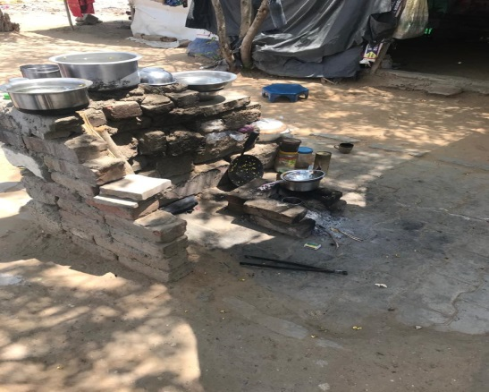
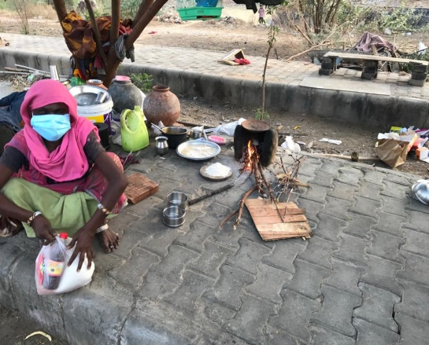
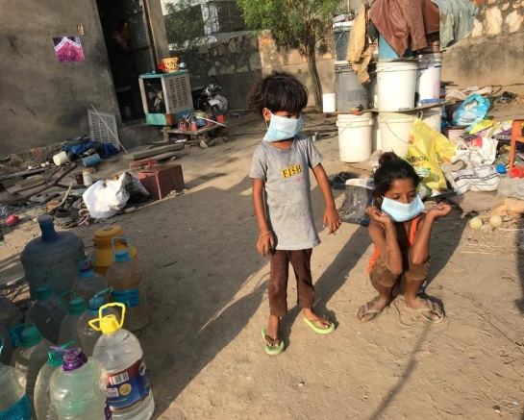
Ongoing projects
1) Let’s end hunger together
Hunger is a real issue and we are on a mission to end hunger forever. We are continuously helping the underprivileged and the needy with ration and food packets.

Slide 28
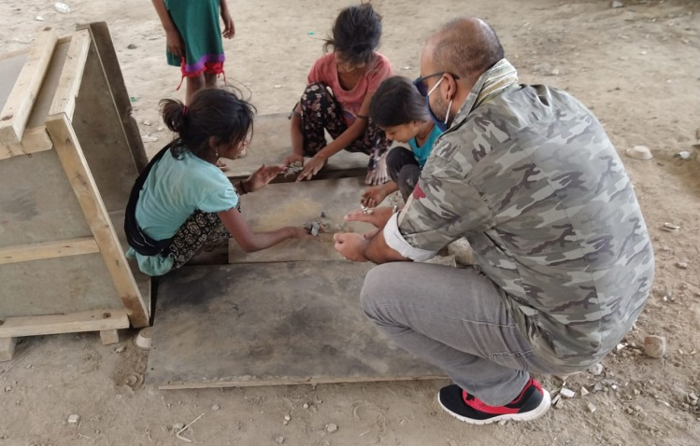
2) They want to study
Every child has the right to study. But some are not able to do so because of many reasons; financial problem is one main reason among the underprivileged people. We met so many such children who really want to go to school. They need our support. Hence we are encouraging people to send their children to school by providing books and other study materials for such underprivileged children so that they are not deprived of the basic right of education.

Slide 29
3) Financial support for medical emergencies
We all know how expensive hospital bills are nowadays. During such a crisis we know how badly a family gets affected mentally. On top of that financial burden makes the situation worse. Hence we help such families who need financial support during such medical emergencies.

Slide 30
Upcoming Grand Project
Indian Differently-Abled Premiere League:
We are organizing cricket tournament for the differently abled players on a national level. For more info, stay tuned.

Slide 31
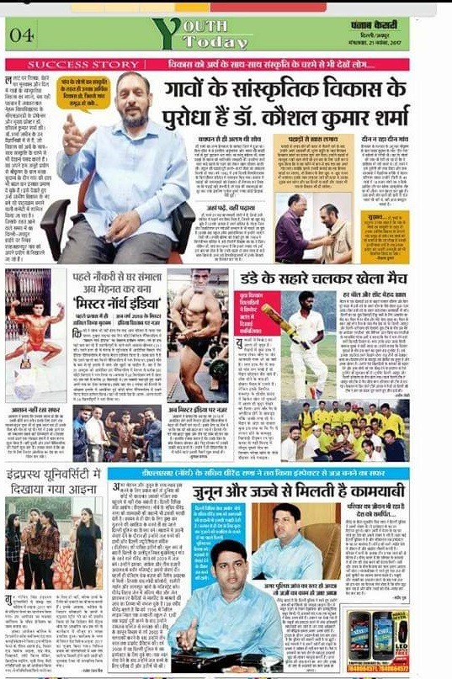
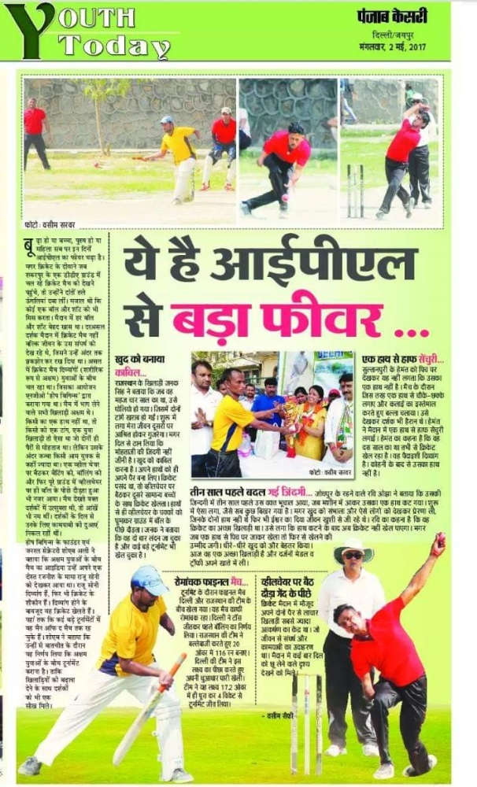
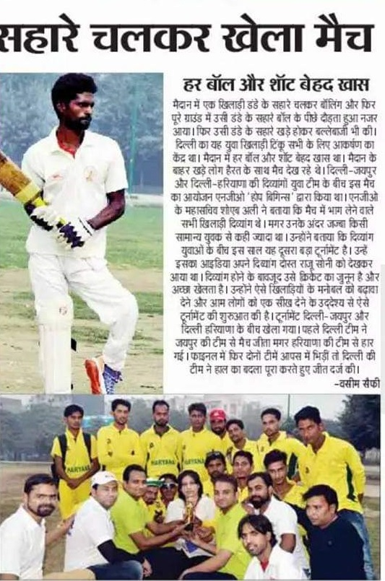
Media room

Slide 32
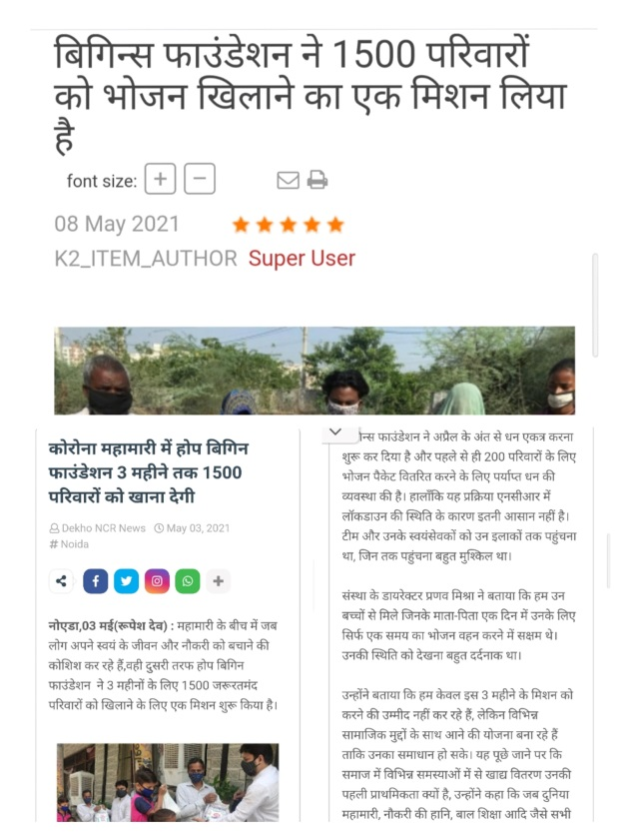
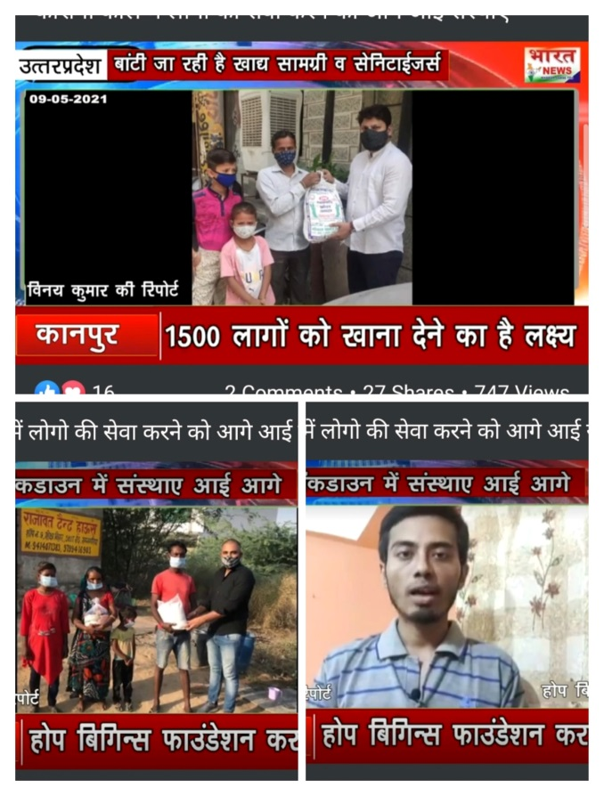
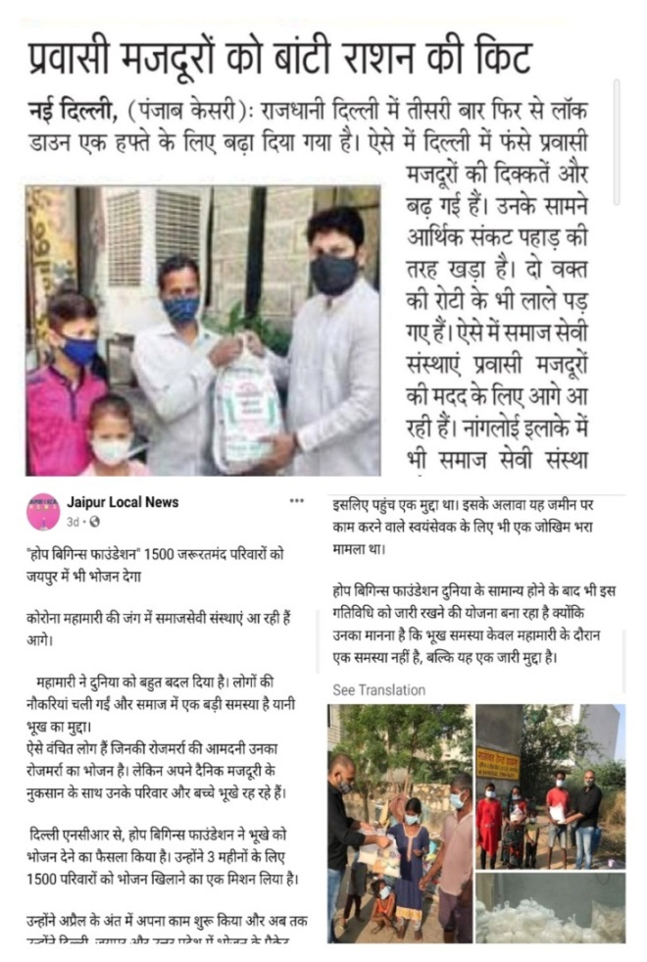

Slide 33
Media links
Coverage by Bharat news-
https://youtu.be/-6f3MKL8lSQ
Article on The Indian Saga –
https://theindiasaga.com/saga-corner/pranav-mishra-shoaib-ali-on-a-mission-to-change-lives-with-hope-begins-foundation/
Article on Daily hunt –
http://dhunt.in/hodyE?s=a&uu=0xf2be09092349b9fc&ss=pd
News night live –
https://newsnight.live/?p=795
Delhi news channel –
http://delhinewschannel.in/index.php/item/1313-1500
Jaipur local news –
https://m.facebook.com/story.php?story_fbid=1681244635407581&id=691281554403899&sfnsn=wiwspmo
Dekho ncr news –
https://www.dekhoncrnews.com/2021/05/3-1500.html?m=1

Slide 34
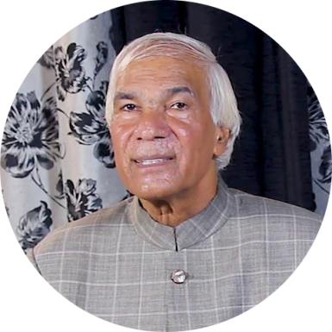
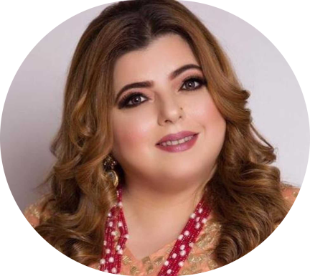
Our Well wishers
We have received appreciation and moral support from many renowned personalities. Their bytes are available on all our social media platforms.
“According to the Vedas, among all kinds of donations food donation is considered the best. Glad to see Hope Begins foundation feeding the hungry.”
Dr. Vachaspati Kulwant, Pro Vice Chancellor – Patanjali University
“During the pandemic people are trying to be inside their homes. But you people are going out and feeding the needy. That is such a noble cause”
Delnaaz Irani, Bollywood actress

Slide 35
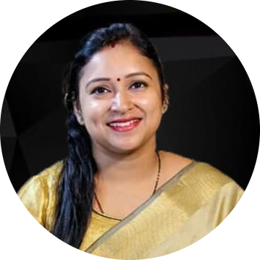
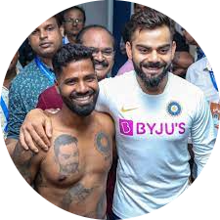
“You are doing such a great work. We all should get together to bring an end to hunger.”
Dr. Shashi Pandey Sharma,
Deputy Director of DVM group of schools,
Country head of Petals group of schools
“Great social work is being done by Hope Begins Foundation. I wish them all the best.”
Pintu Behera, Public figure & a superfan of Virat Kohli

Slide 36
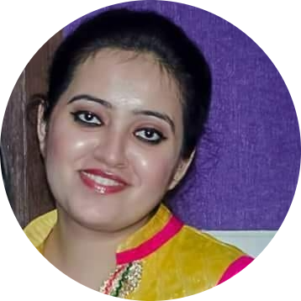
“You are bringing back a ray of hope to those who completely lost hopes. All the best Hope Begins Foundation”
Sumeet Gogia, Author and Motivational Speaker
“I salute your efforts to feed those underprivileged people and labourers who were affected by the pandemic.”
Swati Sharma, Author and Life skills trainer

Slide 37
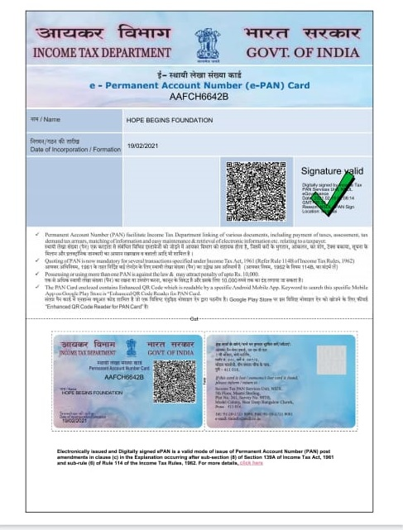
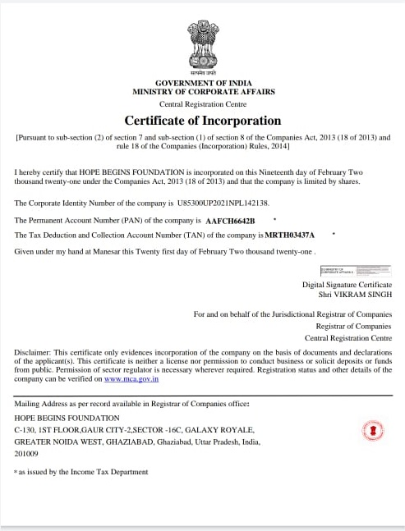
Legal Documents

Slide 38
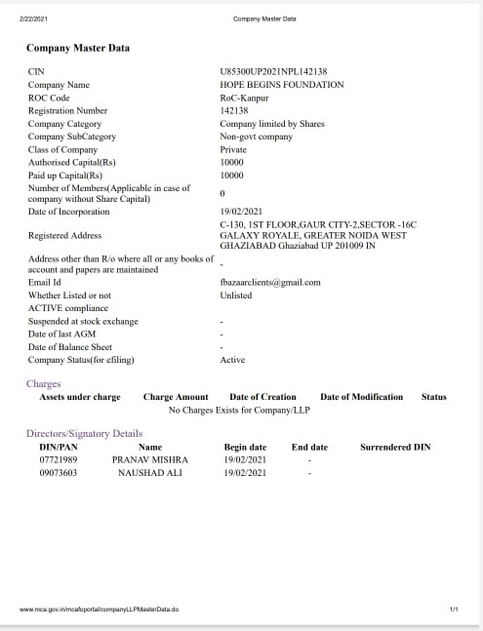
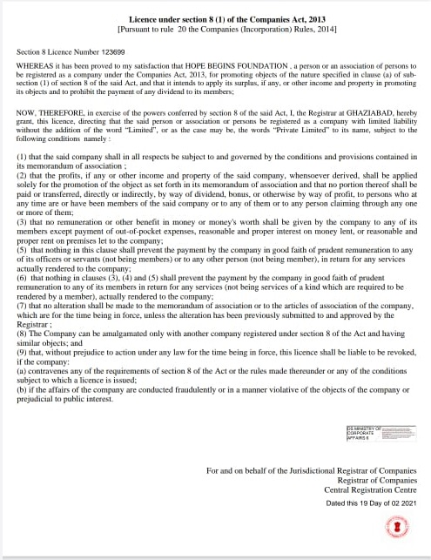

Slide 39
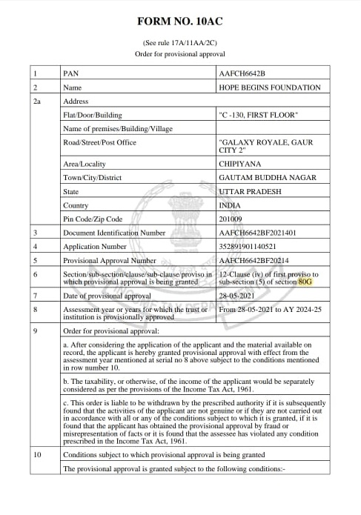

Slide 40
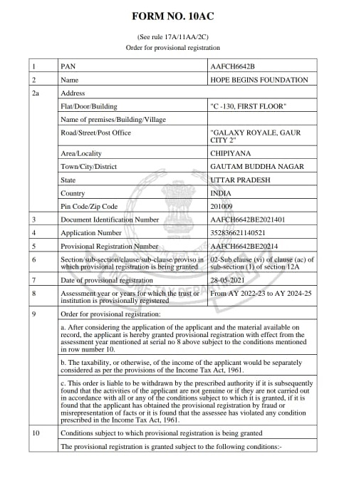
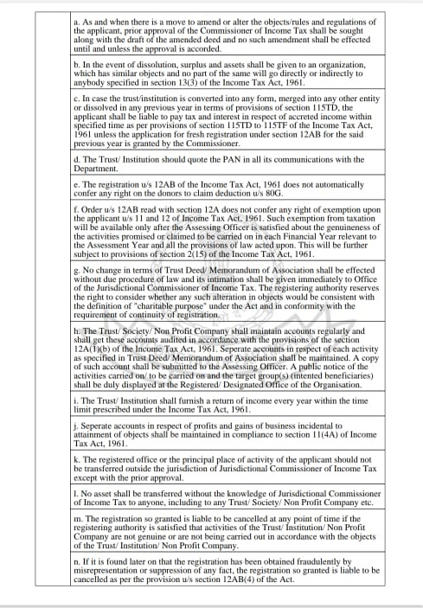
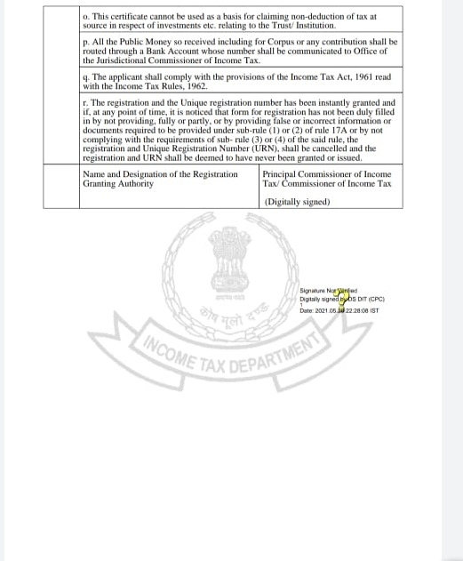

Slide 41
Thank you

